Slide 1


Additional Learning Needs & Educational Tribunal Act

Slide 2
Additional Learning needs in st. joseph’s
ALNCO – Mrs J Dunstan
School Provision: Three stage process
1) In St Joseph’s School the teaching of pupils with ALN is a whole-school responsibility. The core of the teachers’ work involves a continuous cycle of planning, teaching, and assessing.
2) Identified groups of pupils receive additional support, according to available resources and level of need – this may be educational, emotional, social and/or behavioural. These interventions may be short term and are part of our normal practice.
3) Pupil identified as having: a significantly greater difficulty in learning than the majority of others of the same age (The Additional Learning Needs Code For Wales 2021) may be defined as having ALN and school staff will assess these pupils individually, working in collaboration with parents/carers and appropriate agencies.

Slide 3
Vale of glamorgan website information
Additional information is available – just follow the link:
https://www.valeofglamorgan.gov.uk/en/living/schools/Additional-Learning-Needs/Additional-Learning-Needs.aspx

Slide 4

The Index for Children and Young People with Disabilities or Additional Needs
The Index is for families who have children age 0-18 years, who have a disability or additional need and live in the Vale of Glamorgan.
It’s a way of us keeping families informed about what’s available locally and nationally.
You’ll receive a newsletter every three months, packed full with information about events, activities, playschemes and services, as well as regular ebulletins. You can also contact us directly with any questions you have.
Sign up is free and completely voluntary and you don’t need to have a diagnosed disability.
There is more information on our web pages, as well as a quick video and an online registration form: www.valeofglamorgan.gov.uk/theindex
The Index video:
English https://www.youtube.com/watch?v=EX5nSx082PU
Welsh version https://www.youtube.com/watch?v=ArURUQW2JyM

Slide 5
ALN & Dispute resolution
In the Vale of Glamorgan we are always keen to try to address any concerns, worries or issues as soon as possible and this should be done by raising any issues with your child’s school in the first instance.
As far back as the draft ALN Code (2017) principles for good practice in the avoidance and early resolution of
disagreements around Additional Learning Needs. (WG, 2017. pp. 169) were identified.
These good practice principles are:
Support to ensure parents can attend and contribute to meetings (face to face or virtual)
Ensure communication is inclusive and sensitive so parents feel like equal partners
open questioning in meetings so concerns and misunderstandings are dealt with early on
Face to face meetings to plan the way forward
All parties have the same information from the same trusted source
Timely and consistent communication so trust is built
Positive, open and constructive dialogue
Explain the legislation underpinning decisions and
signposting to further information
Decisions are properly explained in inclusive language to parent and child / Young Person
Supporting the examination of the IDP so decisions are transparent and all evidence has been considered
(

Slide 6
ALN & Dispute resolution
All schools should have staff trained in dispute resolution strategies to support this process.
A short film produced by the Welsh Government providing an overview of the avoiding disagreement and early dispute resolution aspect of the ALN Bill now Act can be found at :
https://www.youtube.com/watch?v=FzPllzbheI8 or click the link below.
Avoiding disagreements and earlier dispute resolution - YouTube
Following these strategies should help parents and school work together in a mutually supportive and honest partnership, with the child at the centre to disuses and resolve any issues.
Parents can seek further advice from www.snapcymru.org

Slide 7
ALN & Dispute resolution
SNAP Cymru provides information, advice and support for parents, children and young people who have, or may have, Additional Learning Needs or disabilities
SNAP Cymru provide the following impartial, confidential and free services:
Helpline Information, Advice and Support
Specialist Casework
Discrimination Advice and Casework
Independent Specialist ALN Advocacy
Disagreement Resolution
Children, young people or parents can contact SNAP Cymru on:
0808 801 0608 or visit www.snapcymru.org an ALN enquiry can be submitted using the form on www.snapcymru.org/contact
To request a dispute resolution service
email: DRS@snapcymru.org or for more information on dispute resolution see https://www.snapcymru.org/mediation/

Slide 8


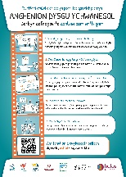
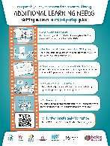


Parental information list
(overview of documents which have been uploaded separately )
Parent/carers and those supporting CYP with ALN
Resource | Welsh Format | English Format
Jargon buster an Information, Advice and Guidance booklet for parents /carers A3 - Parent information poster ALN step by step guide to appeals
Whiteboard animation - Parent /carer Guide to ALN support | https://youtu.be/z9633ZL9zls | https://youtu.be/ISba05AGqJk

Slide 9
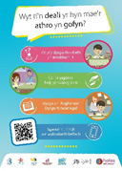
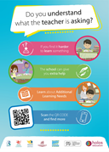
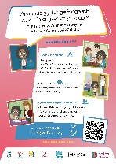
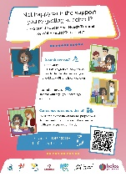
Children and young people
Resource | Welsh Format | English Format
A3- CYP information poster Animation video – information supporting Children and young people (CYP) to seek advice if struggling in school/college. | https://youtu.be/RT1y2pqSYhA | https://youtu.be/Dst2Gs-tzp0
A3- CYP information poster SENTW |  | k
Animation video – information supporting Children and young people (CYP) of the role of SENTW | https://youtu.be/d53YS4wQuBA | https://youtu.be/8lgj3Wm5R5I

Slide 10
Parental information list
(overview of documents which have been uploaded separately )
To access all video clips at once please use the following link:
https://www.youtube.com/playlist?list=PLhSmMGgX6cin37FQS9NAbYSx6xrOTvEF4

Slide 11
Parent flow charts
(overview of documents which have been uploaded separately )

